Slide 1
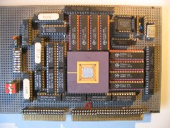
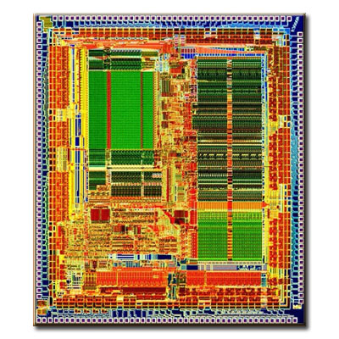
Computation II
5EIB0
Instruction Set Architecture
(ISA)
Henk Corporaal
February 2016
MIPS_3000

Slide 2
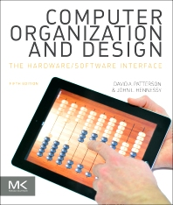

What do you learn today?
RECAP of MIPS ISA:
Basic instruction set of any computer
Machine code (format, structure)
Important RISC principles
Addressing modes
How to translate C into Assembly code
Use of SPIM simulator
Book: Patterson&Hennessy Computer Organization, 5th ed
study chapter 2.1-2.11, extra reading 2.12-2.14
(NOTE: 4th ed: 2.1-2.11, reading 2.12-2.14)

Slide 3
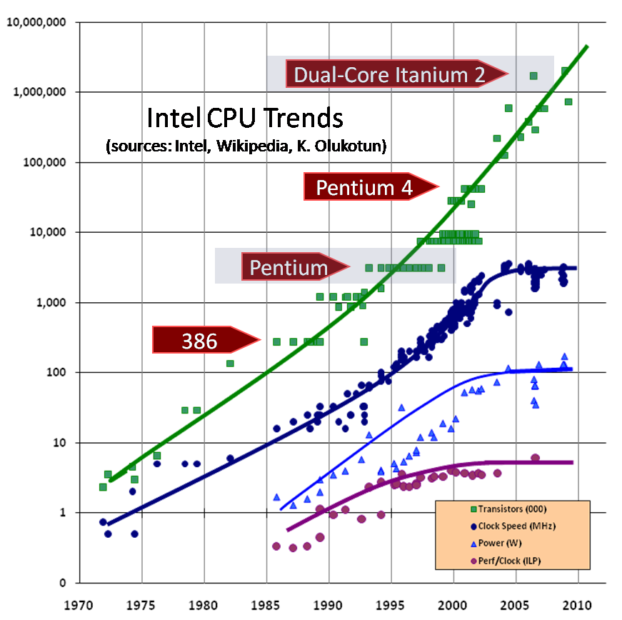
Crisis?
Core i7
3GHz
100W
Trends:
#transistors follows Moore
but not freq. and performance/core
5

Slide 4
Conceptual structure of a computer system; How does it operate?
Instruction
memory
Data
memory
Processor
I/O
interfaces
Input and output
devices

Slide 5
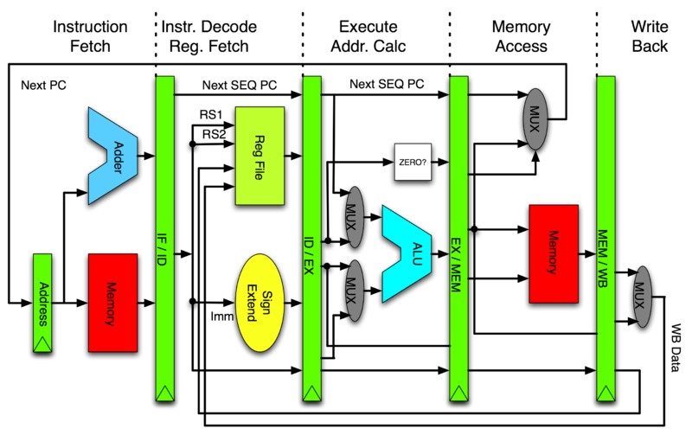
What’s inside the processor? E.g., Pipelined MIPS
PC

Slide 6
How does this pipeline operate?
let's take a load instruction at address 0x800:
0x800 lw $s1, 8($s2)
Every instruction passes 5 stages (= 5 cycles):
Cycle 1
Fetch instruction to which PC (Program Counter) points
New PC = PC+4
Cycle 2
Decode instruction
Fetch $s2 from register file
Cycle 3
Execution: Add 8 to $s2
Cycle 4
Fetch data from address (8+$s2)
Cycle 5
Write data back to register file location $s1

Slide 7
Types of Instructions of any Computer
Basically we need only 3 types of instructins/operations:
Arithmetic
Integer
Floating Point
Memory access
Load & Store
Control flow
Jump
Conditional Branch
Call & Return

Slide 8
MIPS arithmetic
C code: A = B + C + D; E = F - A; MIPS code: add $t0, $s1, $s2 add $s0, $t0, $s3 sub $s4, $s5, $s0
Operands must be registers,
Only 32 registers provided, why not more?
Design Principle: smaller is faster. Why?

Slide 9
Registers vs. Memory
Operands of arithmetic instructions must be registers
MIPS has 32 (integer) registers
Compiler associates variables with registers
Question: What about programs with >32 of variables ?
Memory
CPU
register file
32 registers
IO

Slide 10
Instructions: Load and store
Example: C code: A[8] = h + A[8]; MIPS code: lw $t0, 32($s3) add $t0, $s2, $t0 sw $t0, 32($s3)
Store word operation has no destination (reg) operand
Remember: on a RISC processor arithmetic operands are registers, not memory!

Slide 11
Machine Language: Arithmetic
Instructions are also 32 bits long
Example: add $t0, $s1, $s2
Registers have numbers: $t0=9, $s1=17, $s2=18
Instruction Format (R-type):
op rs rt rd shamt funct
000000 10001 10010 01001 00000 100000
6 bits
5 bits
5 bits
5 bits
5 bits
6 bits
Question: Can you guess what the field names stand for?

Slide 12
Machine Language: Load & Store
Example: lw $t0, 32($s2)
Introduce a new type of instruction format: I-type
35 18 9 32
op rs rt 16 bit number
Question: Where's the compromise?

Slide 13
Control
Decision making instructions
alter the control flow,
i.e., change the "next" instruction to be executed
MIPS conditional branch instructions: bne $t0, $t1, Label beq $t0, $t1, Label
Example: if (i==j) h = i + j; bne $s0, $s1, Label add $s3, $s0, $s1 Label: ....

Slide 14
Control
MIPS unconditional branch instructions: j label
Example: if (i!=j) beq $s4, $s5, Lab1 h=i+j; add $s3, $s4, $s5 else j Lab2 h=i-j; Lab1: sub $s3, $s4, $s5 Lab2: ...

Slide 15
So far:
Instruction Meaning
add $s1,$s2,$s3 $s1 = $s2 + $s3 sub $s1,$s2,$s3 $s1 = $s2 – $s3 lw $s1,100($s2) $s1 = Memory[$s2+100] sw $s1,100($s2) Memory[$s2+100] = $s1 bne $s4,$s5,L Next instr. is at Label if $s4 ≠ $s5 beq $s4,$s5,L Next instr. is at Label if $s4 = $s5 j Label Next instr. is at Label
Formats:
op rs rt rd shamt funct
R
I
J
op rs rt 16 bit address
op 26 bit address

Slide 16
MIPS compiler conventions

Slide 17
Constants
50% of operands are small constants !! e.g., A = A + 5; B = B + 1; C = C - 18;
How to support them?
put 'typical constants' in memory and load them?
create hard-wired registers (like $zero) for small constants?
. . . ???
MIPS Instructions: addi $29, $29, 4 slti $8, $18, 10 andi $29, $29, 6 ori $29, $29, 4

Slide 18
How to construct larger constants?
Must use two instructions to construct any 32-bit number; new "load upper immediate" instruction:
lui $t0, 1010101010101010
filled with zeros
1010101010101010
0000000000000000
Then must get the lower order bits right, i.e., ori $t0, $t0, 1010101010101010
1010101010101010
0000000000000000
0000000000000000
1010101010101010
ori
1010101010101010
1010101010101010

Slide 19
Addresses in Branches and Jumps
Instructions:
bne $t4,$t5,Label Next instruction is at Label if $t4 ≠ $t5
beq $t4,$t5,Label Next instruction is at Label if $t4 = $t5
j Label Next instruction is at Label
Formats:
Questions: Above addresses are not 32 bits; they are 16 & 26 bits !!
How do we extend them to 32 bits?
I
op
rs
rt
16 bit address
J
op
26 bit address

Slide 20
Addresses in Branches and Jumps
Instructions:
bne $t4,$t5,Label Next instruction is at Label if $t4 ≠ $t5
beq $t4,$t5,Label Next instruction is at Label if $t4 = $t5
j Label Next instruction is at Label
Branch
PC_next = PC_branch + 4 + ( Instr[15..0] || [00] ), or
PC_next = PC_branch + 4 + 4*Label
Jump: use high order (4) bits of PC
32-bit Jump address = PC[31..28] || Instr[25..0] || [00]
Address boundaries of 256 MB
Questions:
Why do we concat 2 zero’s for instruction addresses?
Why don’t we do this for data memory addresses?
Concatenating bits

Slide 21
MIPS has (only) 3 data addressing modes
data operands
next instruction address

Slide 22
To summarize:

Slide 23
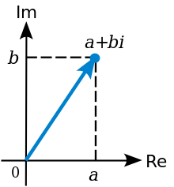
More complex:
Inequalities
While statement
Procedure / Function
leaf
non-leaf / recursive
Stack usage
Further (study your book for these ones)
Case/Switch statement
Arrays vs Pointers
Strings and String Copy

Slide 24
Inequalities
We have: beq, bne, what about Branch-if-less-than?
New (arithmetic) instruction needed:
slt $t0, $s1, $s2 // $t0 = 1 if $s1<Ss2, else 0
Can use this to build a ‘blt’ pseudo instruction e.g.:
blt $s1, $s2, Label
you can now build all general control structures !!
Question: What is a pseudo instruction?

Slide 25
While statement
while (save[i] == k)
i=i+j;
Registers allocation:
i $s3
base of save[] $s6
k $s5
# calculate address of
# save[i]
Loop: muli $t1,$s3,4
add $t1,$t1,$s6
lw $t0,0($t1)
bne $t0,$s5,Exit
add $s3,$s3,$s4
j Loop
Exit:
sll $t1,$s3,2
Faster alternative

Slide 26
Function call / return
Function call
jal label
jump to label (i.e. starting address of the callee),
and make $ra = PC+4
Function return
jr $ra
new PC = $ra
Return address (ra)
is kept in $ra = r31 on MIPS

Slide 27
Using a Stack
low address
Save $s0 and $s1:
subi $sp,$sp,8
sw $s0,4($sp)
sw $s1,0($sp)
empty
$sp
filled
Restore $s0 and $s1:
lw $s0,4($sp)
lw $s1,0($sp)
addi $sp,$sp,8
high address
Convention: $ti registers do not have to be saved and restored by callee;
They are scratch registers
Question: Who takes care when changing $ti registers?

Slide 28
Compiling a leaf procedure / function
C code
int leaf_example (int g, int h, int i, int j)
{
int f;
f = (g+h)-(i+j);
return f;
}
Assembly code:
leaf_example: - save $si registers changed by callee
- code for expression ‘f = ....’
(g is in $a0, h in $a1, etc.)
- put return value in $v0
- restore saved registers
- return: jr $ra

Slide 29
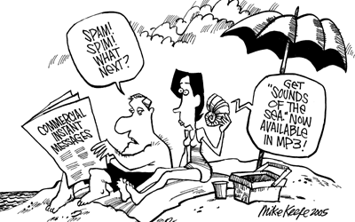
Let’s simulate: SPIM
Install PCSpim
http://spimsimulator.sourceforge.net/
Documentation
book: appendix B.9
www.cs.wisc.edu/~larus/SPIM/spim_documentation.pdf

Slide 30
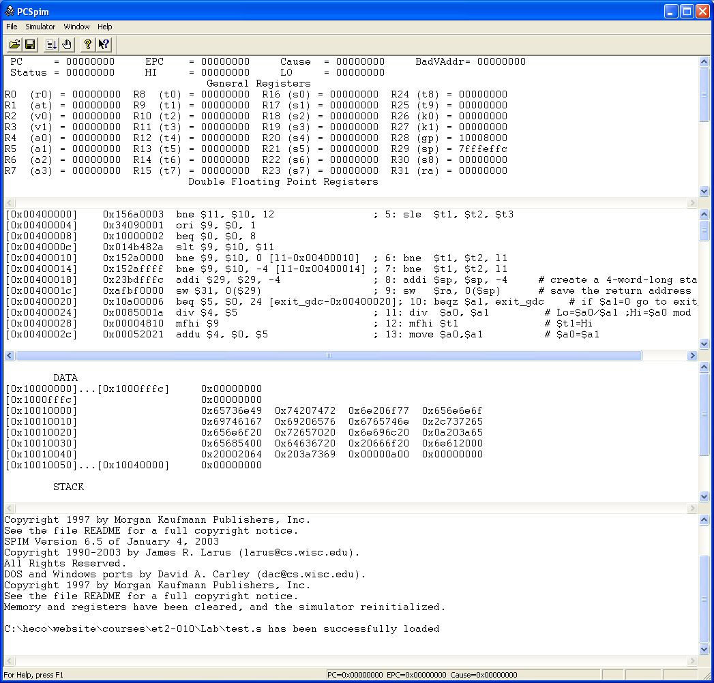
SPIM in action
MIPS registers
Program memory
Data memory
Messages

Slide 31
SPIM example 1: add two numbers
# $t2 - used to hold the sum of the $t0 and $t1.
# $v0 - syscall number, and syscall return value.
# $a0 - syscall input parameter.
.text # Code area starts here
main:
li $v0, 5 # read number into $v0
syscall # make the syscall read_int
move $t0, $v0 # move the number read into $t0
li $v0, 5 # read second number into $v0
syscall # make the syscall read_int
move $t1, $v0 # move the number read into $t1
add $t2, $t0, $t1
move $a0, $t2 # move the number to print into $a0
li $v0, 1 # load syscall print_int into $v0
syscall #
li $v0, 10 # syscall code 10 is for exit
syscall #
# end of main
Assembler directive
starts with a dot
Special SPIM
instruction: system call

Slide 32
SPIM/MIPS assembly directives
.data start data segment
.ascii str store the string str in memory without '\0'
.asciiz str idem, with '\0'
.byte 3,4,16 store 3 byte values
.double 3.14, 2.72 store 2 doubles
.float 3.14, 2.72 store 2 floats
.word 3,4,16 store 3 32-bit quantities
.space 100 reserve 100 bytes
.text start text segment

Slide 33
SPIM syscall examples
Service | Trap code | Input | Output
print_int | $v0 = 1 | $a0 = integer to print | prints $a0 to standard output
print_float | $v0 = 2 | $f12 = float to print | prints $f12 to standard output
print_double | $v0 = 3 | $f12 = double to print | prints $f12 to standard output
print_string | $v0 = 4 | $a0 = address of first character | prints a character string to standard output
read_int | $v0 = 5 |  | integer read from standard input placed in $v0
read_float | $v0 = 6 |  | float read from standard input placed in $f0
read_double | $v0 = 7 |  | double read from standard input placed in $f0
read_string | $v0 = 8 | $a0 = address to place string, $a1 = max string length | reads standard input into address in $a0
sbrk | $v0 = 9 | $a0 = number of bytes required | $v0= address of allocated memory Allocates memory from the heap
exit | $v0 = 10
print_char | $v0 = 11 | $a0 = character (low 8 bits)
read_char | $v0 = 12 |  | $v0 = character (no line feed) echoed
file_open | $v0 = 13 | $a0 = full path (zero terminated string with no line feed), $a1 = flags, $a2 = UNIX octal file mode (0644 for rw-r--r--) | $v0 = file descriptor
file_read | $v0 = 14 | $a0 = file descriptor, $a1 = buffer address, $a2 = amount to read in bytes | $v0 = amount of data in buffer from file (-1 = error, 0 = end of file)
file_write | $v0 = 15 | $a0 = file descriptor, $a1 = buffer address, $a2 = amount to write in bytes | $v0 = amount of data in buffer to file (-1 = error, 0 = end of file)
file_close | $v0 = 16 | $a0 = file descriptor

Slide 34
SPIM example 2: sum N numbers
Input:
number of inputs, n,
n integers;
Query the user for these n+1 numbers; first put message on output display
Output: Sum of integers
display this sum

Slide 35
SPIM example 2: sum N numbers
# Input: number of inputs, n, and n integers; Output: Sum of integers
.data # Data memory area.
prmpt1: .asciiz "How many inputs? "
prmpt2: .asciiz "Next input: "
sumtext: .asciiz "The sum is "
.text # Code area starts here
main: li $v0, 4 # Syscall to print prompt string
la $a0, prmpt1 # li and la are pseudo instr.
syscall
li $v0, 5 # Syscall to read an integer
syscall
move $t0, $v0 # n stored in $t0
li $t1, 0 # sum will be stored in $t1
while: blez $t0, endwhile # (pseudo instruction)
li $v0, 4 # syscal to print string
la $a0, prmpt2
syscall
li $v0, 5
syscall
add $t1, $t1, $v0 # Increase sum by new input
sub $t0, $t0, 1 # Decrement n
j while
endwhile: li $v0, 4 # syscal to print string
la $a0, sumtext
syscall
move $a0, $t1 # Syscall to print an integer
li $v0, 1
syscall
li $v0, 10 # Syscall to exit
syscall

Slide 36
Exercise 1: For Loop
Translate the following C-loop into MIPS assembly code. For variables x and y use registers $5 and $6 respectively.
Test it out with SPIM
int x, y;
for (x=0, y=100; x != y; x++, y--) ;

Slide 37
Exercise 2: Sum N numbers
Input:
number of inputs, n,
n integers;
Query the user for these n+1 numbers; first put message on output display
Output: Sum of integers
display this sum
Again: test it out with SPIM

Slide 38

What did you learn so far?

Slide 39

3 Types of instructions:
Arithm., Data access, Control
3 Instruction formats: R, I, J
Main MIPS instructions
Compiler conventions about register use
Addressing modes
Some RISC principles
Supply lots of registers
avoid unnecessary loads and stores
Arithmetic instructions may only use register operands
Few instruction formats
easy to decode
Few operand addressing modes
Only 1 instruction length (32 bits)
With bne, beq, j and slt you can code any loop and if-statement
Use of SPIM

Slide 40

FurtherTopics
Study the book for the following related topics:
compiling non-leaf procedure / function
register allocation using graph coloring
alignment of data
floating point instructions
characters and strings
string copy code
case statement

